Slide 1
Test Mastery
Mini-Lesson 7 | Science
Guessing

Slide 2
Guessing
X.1
X.2
Learning Targets
Use the limitations of the ACT test format to improve the
accuracy of guesses.
Apply statistically effective strategies when making a random
guess.
Practice applying the Column Counting strategy.

Slide 3
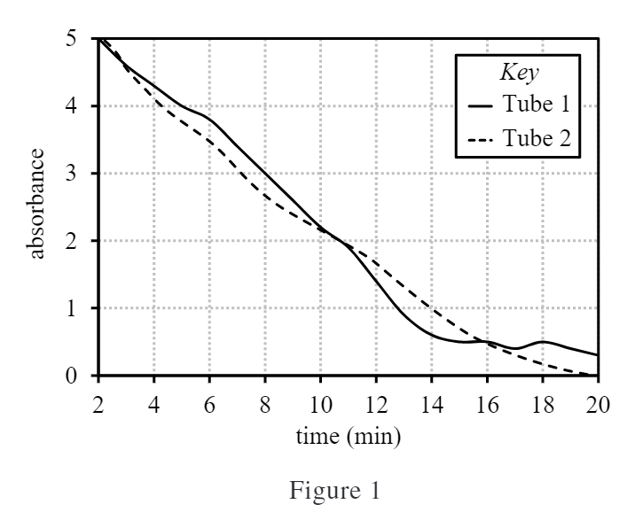
Guessing
X.1
X.1
X.2
1. According to Figure 1, for Tube 2, as time increases, absorption:
increases only.
decreases only.
increases, then decreases.
decreases, then increases.
1 of 2

Slide 4
Guessing
X.1
X.1
X.2
1. According to Figure 1, for Tube 2, as time increases, absorption:
increases only.
decreases only.
increases, then decreases.
decreases, then increases.
2 of 2

Slide 5
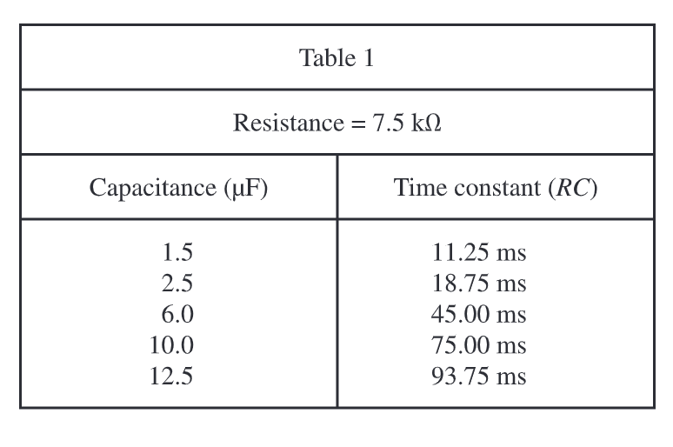
Guessing
X.1
X.1
X.2
2. Based on the data in Table 1, if a capacitor having a value of 3 μF is in series with a resistor having a value of 7.5 kΩ, the time required for the capacitor to reach 63% of its full charge will be:
F) less than 11.25 ms..
G) between 11.25 ms and 18.75 ms.
H) between 18.75 ms and 45.00 ms.
J) greater than 45.00 ms.
1 of 2

Slide 6
Guessing
X.1
X.1
X.2
2. Based on the data in Table 1, if a capacitor having a value of 3 μF is in series with a resistor having a value of 7.5 kΩ, the time required for the capacitor to reach 63% of its full charge will be:
F) less than 11.25 ms..
G) between 11.25 ms and 18.75 ms.
H) between 18.75 ms and 45.00 ms.
J) greater than 45.00 ms.
2 of 2

Slide 7
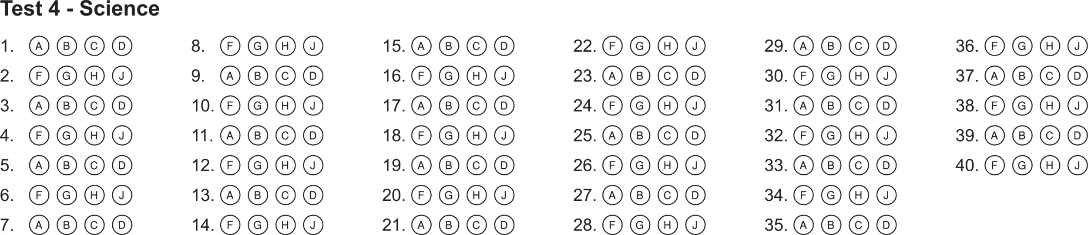
Guessing
X.1
X.1
X.2
Bubble Sheet Strategies
1 of 1

Slide 8
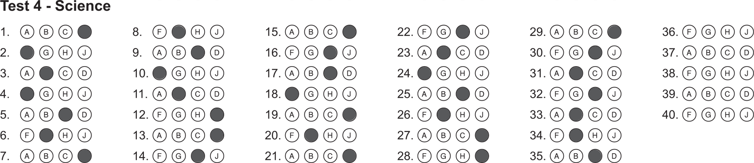
Guessing
X.1
X.1
X.2
Bubble Sheet Strategies
1 of 2

Slide 9
Guessing
X.1
X.1
X.2
Bonus
2 of 2

