Slide 1
Test Mastery
Mini-Lesson 7 | Reading
Guessing

Slide 2
Guessing
X.1
X.2
Learning Targets
Use the limitations of the ACT test format to improve the
accuracy of guesses.
Apply statistically effective strategies when making a random
guess.
Practice applying the Column Counting strategy.

Slide 3
Guessing
X.1
X.1
X.2
1. The author’s attitude toward Dan Barber in the passage is best described as that of:
a close friend but professional rival.
a skeptical food critic and opponent.
an enthusiastic but misguided admirer.
an unbiased and optimistic reporter.
Reveal Answer
1 of 3

Slide 4
Guessing
X.1
X.1
X.2
1. The author’s attitude toward Dan Barber in the passage is best described as that of:
a close friend but professional rival.
a skeptical food critic and opponent.
an enthusiastic but misguided admirer.
an unbiased and optimistic reporter.
Reveal Answer
2 of 3

Slide 5
Guessing
X.1
X.1
X.2
1. The author’s attitude toward Dan Barber in the passage is best described as that of:
a close friend but professional rival.
a skeptical food critic and opponent.
an enthusiastic but misguided admirer.
an unbiased and optimistic reporter.
3 of 3

Slide 6
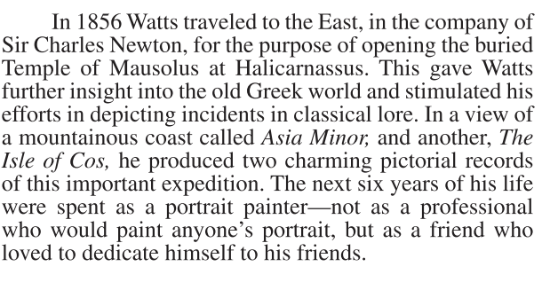
Guessing
X.1
X.1
X.2
2. What does the passage state is Watts’s view of painting personal portraits after returning from his trip to the East?
He considered it his greatest
contribution to the world of art, far
above that of his civic paintings.
He did it purely for financial stability,
since this was a slow period in his
career.
He loathed the subjects of his
paintings, and this can be seen in the
portraits themselves.
He did not do it for economic reasons,
but rather as an act of devotion to
friends.
Reveal Answer
1 of 6

Slide 7
Guessing
X.1
X.1
X.2
2. What does the passage state is Watts’s view of painting personal portraits after returning from his trip to the East?
+
He considered it his greatest
contribution to the world of art, far
above that of his civic paintings.
He did it purely for financial stability,
since this was a slow period in his
career.
He loathed the subjects of his
paintings, and this can be seen in the
portraits themselves.
He did not do it for economic reasons,
but rather as an act of devotion to
friends.
Reveal Answer
2 of 6

Slide 8
Guessing
X.1
X.1
X.2
2. What does the passage state is Watts’s view of painting personal portraits after returning from his trip to the East?
+
He considered it his greatest
contribution to the world of art, far
above that of his civic paintings.
He did it purely for financial stability,
since this was a slow period in his
career.
He loathed the subjects of his
paintings, and this can be seen in the
portraits themselves.
He did not do it for economic reasons,
but rather as an act of devotion to
friends.
–
Reveal Answer
4 of 6

Slide 9
Guessing
X.1
X.1
X.2
2. What does the passage state is Watts’s view of painting personal portraits after returning from his trip to the East?
+
He considered it his greatest
contribution to the world of art, far
above that of his civic paintings.
He did it purely for financial stability,
since this was a slow period in his
career.
He loathed the subjects of his
paintings, and this can be seen in the
portraits themselves.
He did not do it for economic reasons,
but rather as an act of devotion to
friends.
–
+
Reveal Answer
4 of 6

Slide 10
Guessing
X.1
X.1
X.2
2. What does the passage state is Watts’s view of painting personal portraits after returning from his trip to the East?
+
He considered it his greatest
contribution to the world of art, far
above that of his civic paintings.
He did it purely for financial stability,
since this was a slow period in his
career.
He loathed the subjects of his
paintings, and this can be seen in the
portraits themselves.
He did not do it for economic reasons,
but rather as an act of devotion to
friends.
–
–
+
Reveal Answer
5 of 6

Slide 11
Guessing
X.1
X.1
X.2
2. What does the passage state is Watts’s view of painting personal portraits after returning from his trip to the East?
+
He considered it his greatest
contribution to the world of art, far
above that of his civic paintings.
He did it purely for financial stability,
since this was a slow period in his
career.
He loathed the subjects of his
paintings, and this can be seen in the
portraits themselves.
He did not do it for economic reasons,
but rather as an act of devotion to
friends.
–
–
+
6 of 6

Slide 12
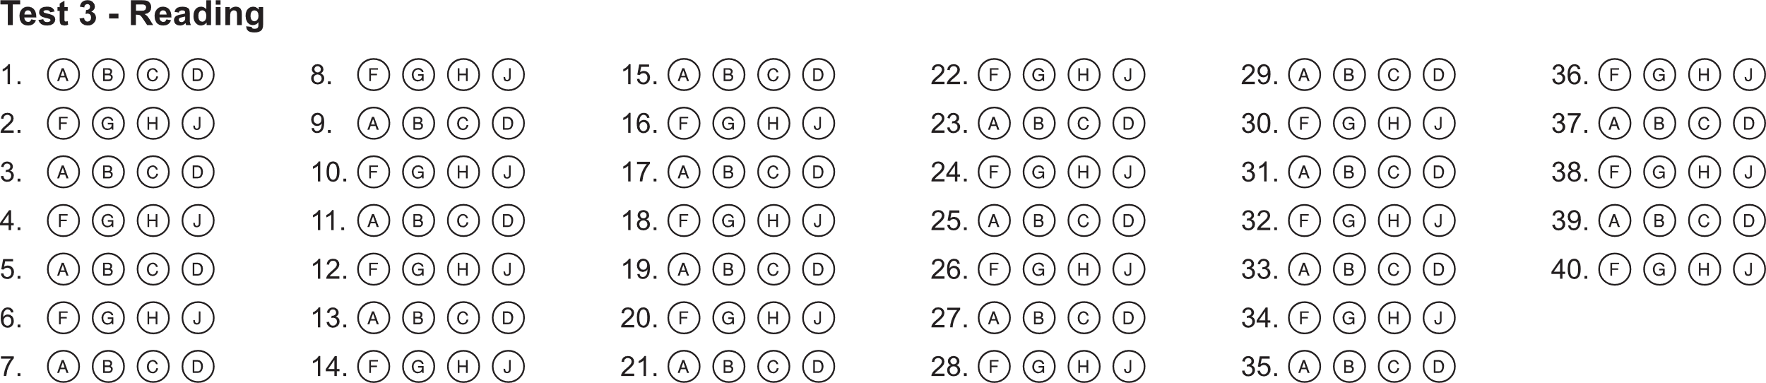
Guessing
X.1
X.1
X.2
Bubble Sheet Strategies
1 of 1

Slide 13
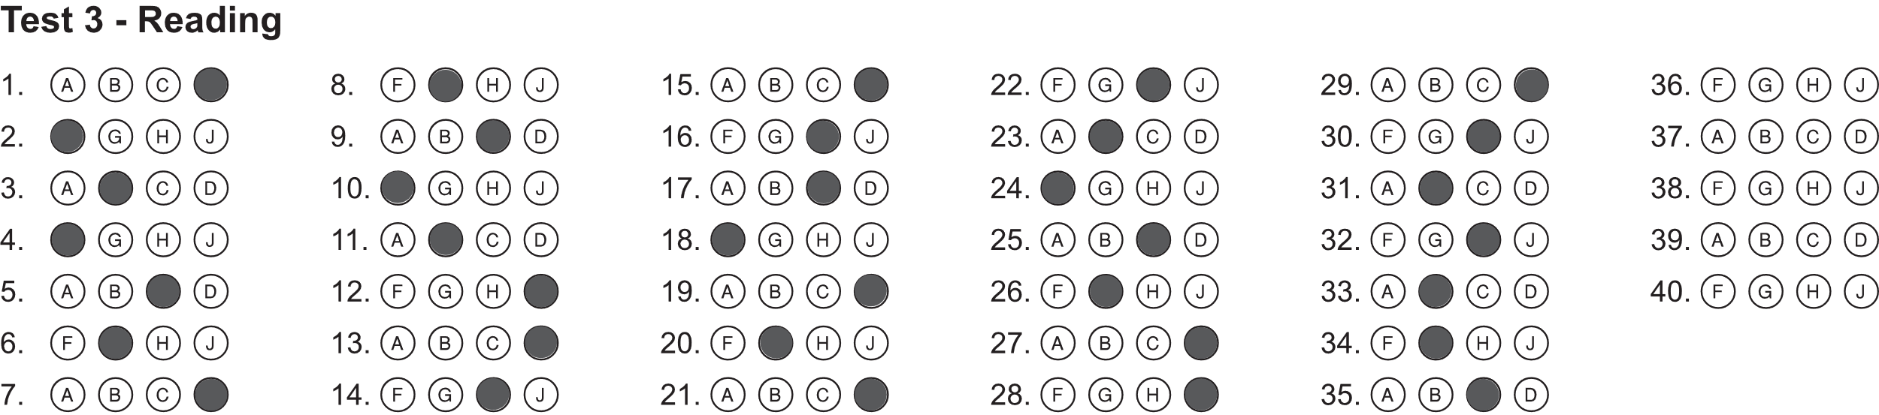
Guessing
X.1
X.1
X.2
Bubble Sheet Strategies
1 of 2

Slide 14
Guessing
X.1
X.1
X.2
Bubble Sheet Strategies
2 of 2

