Slide 1
Test Mastery
Mini-Lesson 7 | English
Guessing

Slide 2
Guessing
Learning Targets
Use the limitations of the ACT test format to improve the
accuracy of guesses.
Apply statistically effective strategies when making a random
guess.
Practice applying the Column Counting strategy.

Slide 3
Guessing
X.1
X.1
X.2
In ancient Hindu religious texts, the myth, of the Vaitarna River is told.
1. A) NO CHANGE
B) the myth, of the Vaitarna
River,
C) the myth of the Vaitarna
River,
D) the myth of the Vaitarna
River
1 of 2

Slide 4
Guessing
X.1
X.1
X.2
In ancient Hindu religious texts, the myth, of the Vaitarna River is told.
1. A) NO CHANGE
B) the myth, of the Vaitarna
River,
C) the myth of the Vaitarna
River,
D) the myth of the Vaitarna
River
2 of 2

Slide 5
Guessing
X.1
X.1
X.2
Inspecting it, he laughed and thanked me for the gift, looking it over.
2. F) NO CHANGE
G) gift, studying it intently.
H) gift, taking its details.
J) gift.
1 of 2

Slide 6
Guessing
X.1
X.1
X.2
Inspecting it, he laughed and thanked me for the gift, looking it over.
2. F) NO CHANGE
G) gift, studying it intently.
H) gift, taking its details.
J) gift.
2 of 2

Slide 7
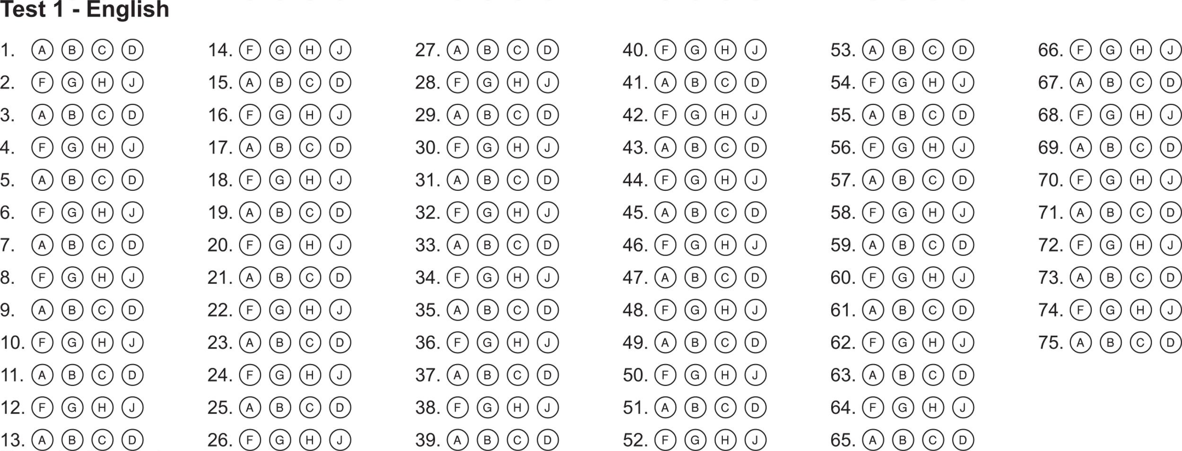
Guessing
X.1
X.1
X.2
Bubble Sheet Strategies
1 of 1

Slide 8
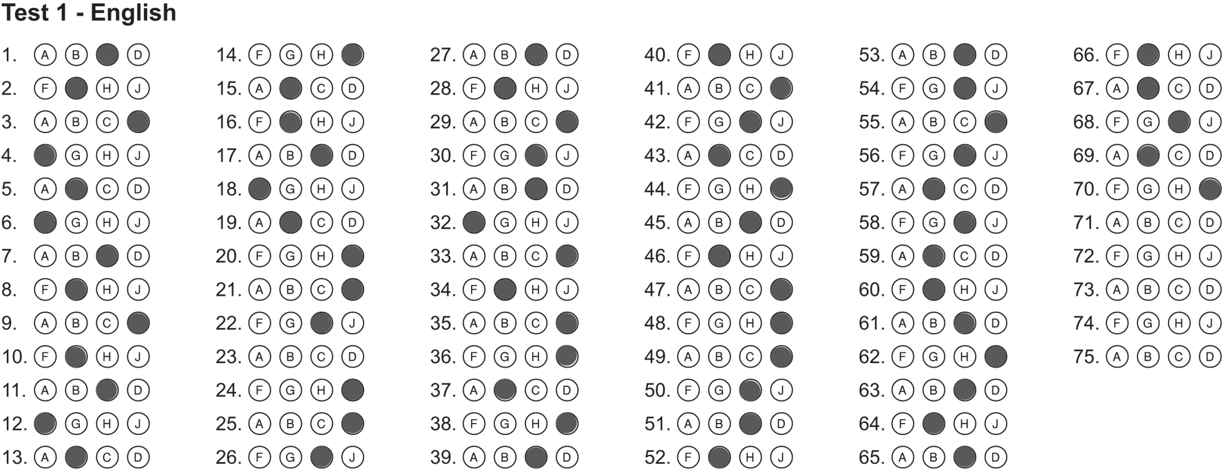
Guessing
X.1
X.1
X.2
Bubble Sheet Strategies
1 of 2

Slide 9
Guessing
X.1
X.1
X.2
Bonus
2 of 2

