Slide 1
Test Mastery
Mini-Lesson 6 | Reading
Elimination

Slide 2
Elimination
X.1
X.2
Learning Targets
Explain why the process of elimination is more effective than
searching for one correct answer.
Use strategies specific to a subject test to improve
elimination skills.

Slide 3
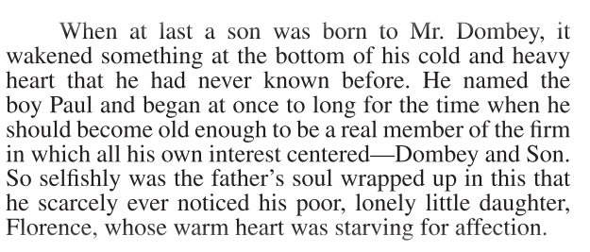
Elimination
X.1
X.1
X.2
1. Lines 1–6 most nearly mean that Mr. Dombey:
had been awakened to a deep
paternal love when his son
was born.
was mainly focused on having
his son follow in his footsteps.
prevented his children from
suffering ill health.
devoted himself to being a
companion for his two
children.
Reveal Answer
1 of 5

Slide 4
Elimination
X.1
X.1
X.2
1. Lines 1–6 most nearly mean that Mr. Dombey:
had been awakened to a deep
paternal love when his son
was born.
was mainly focused on having
his son follow in his footsteps.
prevented his children from
suffering ill health.
devoted himself to being a
companion for his two
children.
Reveal Answer
2 of 5

Slide 5
Elimination
X.1
X.1
X.2
1. Lines 1–6 most nearly mean that Mr. Dombey:
had been awakened to a deep
paternal love when his son
was born.
was mainly focused on having
his son follow in his footsteps.
prevented his children from
suffering ill health.
devoted himself to being a
companion for his two
children.
Reveal Answer
3 of 5

Slide 6
Elimination
X.1
X.1
X.2
1. Lines 1–6 most nearly mean that Mr. Dombey:
had been awakened to a deep
paternal love when his son
was born.
was mainly focused on having
his son follow in his footsteps.
prevented his children from
suffering ill health.
devoted himself to being a
companion for his two
children.
Reveal Answer
4 of 5

Slide 7
Elimination
X.1
X.1
X.2
1. Lines 1–6 most nearly mean that Mr. Dombey:
had been awakened to a deep
paternal love when his son
was born.
was mainly focused on having
his son follow in his footsteps.
prevented his children from
suffering ill health.
devoted himself to being a
companion for his two
children.
5 of 5

Slide 8
Elimination
X.1
X.1
X.2
2. Over the course of the passage, the main focus shifts from
a symbolic description of a talent the narrator has to an example of
its use in context.
an overview of the narrator’s passion for math to a description of
an influential encounter.
a portrayal of the narrator’s aunt to an analysis of a professor with
whom the narrator becomes enthralled.
a story about the difficulty the narrator faced at home to an
observation of the consequences of that difficulty.
Reveal Answer
1 of 3

Slide 9
Elimination
X.1
X.1
X.2
2. Over the course of the passage, the main focus shifts from
a symbolic description of a talent the narrator has to an example of
its use in context.
an overview of the narrator’s passion for math to a description of
an influential encounter.
a portrayal of the narrator’s aunt to an analysis of a professor with
whom the narrator becomes enthralled.
a story about the difficulty the narrator faced at home to an
observation of the consequences of that difficulty.
Reveal Answer
2 of 3

Slide 10
Elimination
X.1
X.1
X.2
2. Over the course of the passage, the main focus shifts from
a symbolic description of a talent the narrator has to an example of
its use in context.
an overview of the narrator’s passion for math to a description of
an influential encounter.
a portrayal of the narrator’s aunt to an analysis of a professor with
whom the narrator becomes enthralled.
a story about the difficulty the narrator faced at home to an
observation of the consequences of that difficulty.
3 of 3

