Slide 1
Test Mastery
Mini-Lesson 6 | Math
Elimination

Slide 2
Elimination
X.1
X.2
Learning Targets
Explain why the process of elimination is more effective than
searching for one correct answer.
Use strategies specific to a subject test to improve
elimination skills.

Slide 3
Elimination
X.1
1. If 3^{x} = 55, then which of the following must be true?
1 < x < 2
2 < x < 3
3 < x < 4
4 < x < 5
x > 5
Reveal Answer
1 of 4

Slide 4
Elimination
X.1
1. If 3^{x} = 55, then which of the following must be true?
1 < x < 2
2 < x < 3
3 < x < 4
4 < x < 5
x > 5
Reveal Answer
2 of 4

Slide 5
Elimination
X.1
1. If 3^{x} = 55, then which of the following must be true?
1 < x < 2
2 < x < 3
3 < x < 4
4 < x < 5
x > 5
Reveal Answer
3 of 4

Slide 6
Elimination
X.1
1. If 3^{x} = 55, then which of the following must be true?
1 < x < 2
2 < x < 3
3 < x < 4
4 < x < 5
x > 5
4 of 4

Slide 7
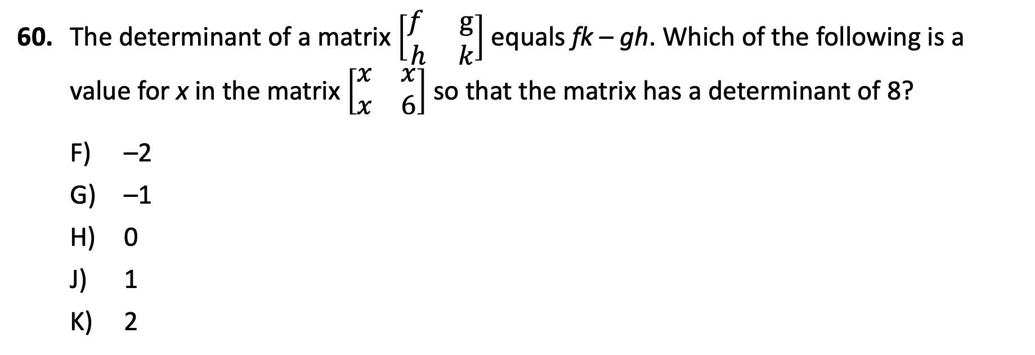
Elimination
X.1
60. The determinant of a matrix $\left[\begin{matrix}f & g \\ h & k\end{matrix}\right]$ equals fk – gh. Which of the following is a value for x in the matrix $\left[\begin{matrix}x & x \\ x & 6\end{matrix}\right]$ so that the matrix has a determinant of 8?
–2
–1
0
1
2
Reveal Answer
1 of 4

Slide 8
Elimination
X.1
60. The determinant of a matrix $\left[\begin{matrix}f & g \\ h & k\end{matrix}\right]$ equals fk – gh. Which of the following is a value for x in the matrix $\left[\begin{matrix}x & x \\ x & 6\end{matrix}\right]$ so that the matrix has a determinant of 8?
–2
–1
0
1
2
Reveal Answer
2 of 4

Slide 9
Elimination
X.1
60. The determinant of a matrix $\left[\begin{matrix}f & g \\ h & k\end{matrix}\right]$ equals fk – gh. Which of the following is a value for x in the matrix $\left[\begin{matrix}x & x \\ x & 6\end{matrix}\right]$ so that the matrix has a determinant of 8?
–2
–1
0
1
2
Reveal Answer
3 of 4

Slide 10
Elimination
X.1
60. The determinant of a matrix $\left[\begin{matrix}f & g \\ h & k\end{matrix}\right]$ equals fk – gh. Which of the following is a value for x in the matrix $\left[\begin{matrix}x & x \\ x & 6\end{matrix}\right]$ so that the matrix has a determinant of 8?
–2
–1
0
1
2
4 of 4

Slide 11
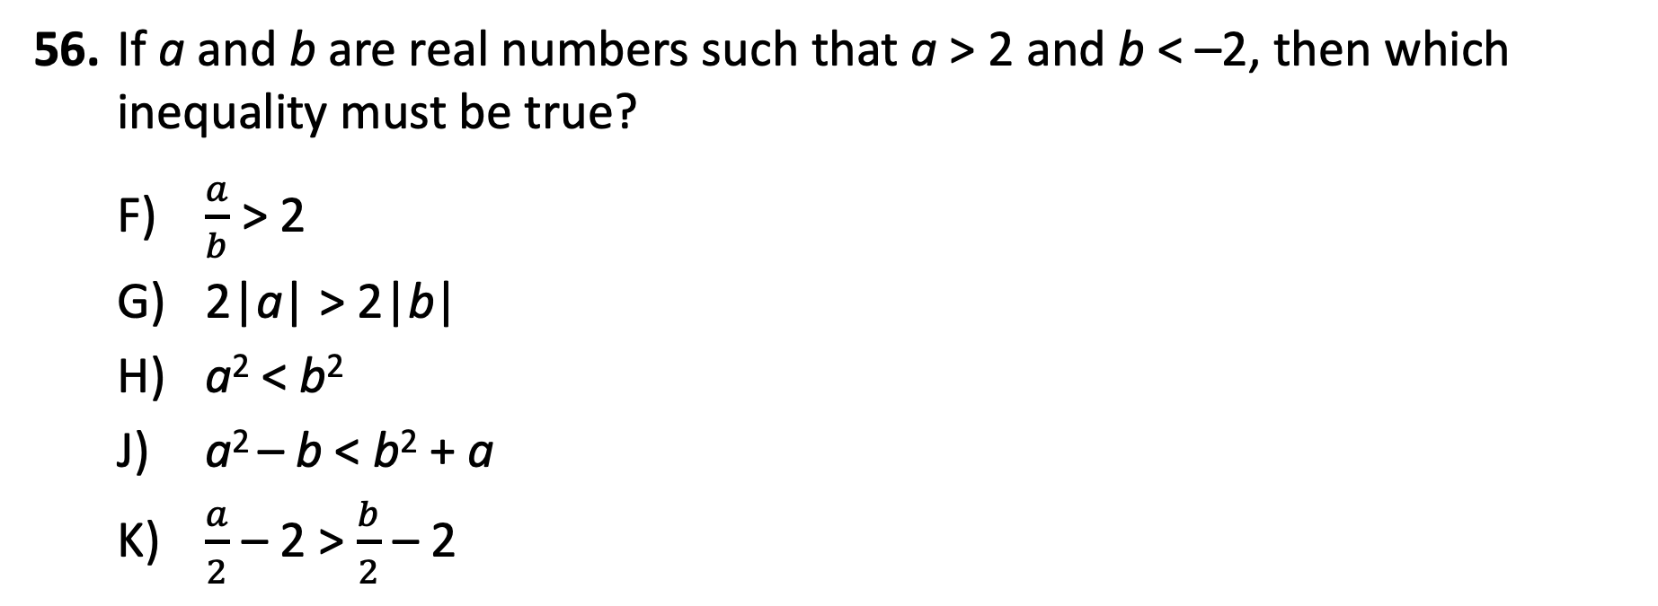
Elimination
X.1
56. If a and b are real numbers such that a > 2 and b < –2, then which inequality must be true?
$\frac{a}{b}$ > 2
2|a| > 2|b|
a² < b²
a² – b < b² + a
$\frac{a}{2}$ – 2 > $\frac{b}{2}$ – 2
Reveal Answer
1 of 6

Slide 12
Elimination
X.1
56. If a and b are real numbers such that a > 2 and b < –2, then which inequality must be true?
$\frac{a}{b}$ > 2
2|a| > 2|b|
a² < b²
a² – b < b² + a
$\frac{a}{2}$ – 2 > $\frac{b}{2}$ – 2
Reveal Answer
2 of 6

Slide 13
Elimination
X.1
56. If a and b are real numbers such that a > 2 and b < –2, then which inequality must be true?
$\frac{a}{b}$ > 2
2|a| > 2|b|
a² < b²
a² – b < b² + a
$\frac{a}{2}$ – 2 > $\frac{b}{2}$ – 2
Reveal Answer
3 of 6

Slide 14
Elimination
X.1
56. If a and b are real numbers such that a > 2 and b < –2, then which inequality must be true?
$\frac{a}{b}$ > 2
2|a| > 2|b|
a² < b²
a² – b < b² + a
$\frac{a}{2}$ – 2 > $\frac{b}{2}$ – 2
Reveal Answer
4 of 6

Slide 15
Elimination
X.1
56. If a and b are real numbers such that a > 2 and b < –2, then which inequality must be true?
$\frac{a}{b}$ > 2
2|a| > 2|b|
a² < b²
a² – b < b² + a
$\frac{a}{2}$ – 2 > $\frac{b}{2}$ – 2
Reveal Answer
5 of 6

Slide 16
Elimination
X.1
56. If a and b are real numbers such that a > 2 and b < –2, then which inequality must be true?
$\frac{a}{b}$ > 2
2|a| > 2|b|
a² < b²
a² – b < b² + a
$\frac{a}{2}$ – 2 > $\frac{b}{2}$ – 2
6 of 6

