Slide 1
Test Mastery
Mini-Lesson 5 | Science
Accuracy

Slide 2
Accuracy
X.1
X.2
Learning Targets
Eliminate answer choices that appear correct at first glance
but have incorrect elements.
Avoid wasting time evaluating outlier options.
Identify common errors that decrease accuracy.

Slide 3
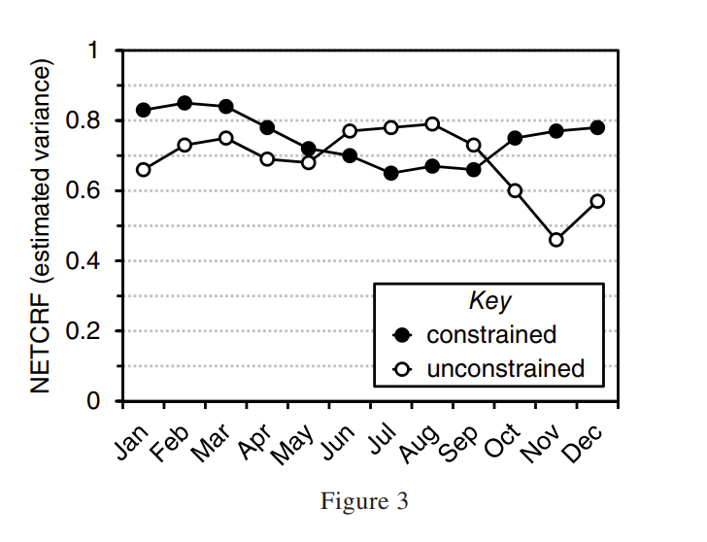
Accuracy
X.1
X.1
X.2
1. The estimated variance for the unconstrained model of cloud radiative
forcing (NETCRF) in March was closest to which of the following?
0.65
0.74
0.83
0.91
Reveal Answer
1 of 3

Slide 4
Accuracy
X.1
X.1
X.2
1. The estimated variance for the unconstrained model of cloud radiative
forcing (NETCRF) in March was closest to which of the following?
0.65
0.74
0.83
0.91
Reveal Answer
1 of 3
2 of 3

Slide 5
Accuracy
X.1
X.1
X.2
1. The estimated variance for the unconstrained model of cloud radiative
forcing (NETCRF) in March was closest to which of the following?
0.65
0.74
0.83
0.91
1 of 3
3 of 3

Slide 6
Accuracy
X.1
X.1
X.2
2. According to the information in Table 1, as the number of mosquitoes
captured within a zone increased, the number of dead crows and blue
jays:
increased only.
decreased only.
decreased, then remained the same.
varied.
Reveal Answer
1 of 3

Slide 7
Accuracy
X.1
X.1
X.2
2. According to the information in Table 1, as the number of mosquitoes
captured within a zone increased, the number of dead crows and blue
jays:
increased only.
decreased only.
decreased, then remained the same.
varied.
Reveal Answer
2 of 3

Slide 8
Accuracy
X.1
X.1
X.2
2. According to the information in Table 1, as the number of mosquitoes
captured within a zone increased, the number of dead crows and blue
jays:
increased only.
decreased only.
decreased, then remained the same.
varied.
3 of 3

