Slide 1
Test Mastery
Mini-Lesson 5 | Reading
Accuracy

Slide 2
Accuracy
X.1
X.2
Learning Targets
Eliminate answer choices that appear correct at first glance
but have incorrect elements.
Avoid wasting time evaluating outlier options.
Identify common errors that decrease accuracy.

Slide 3
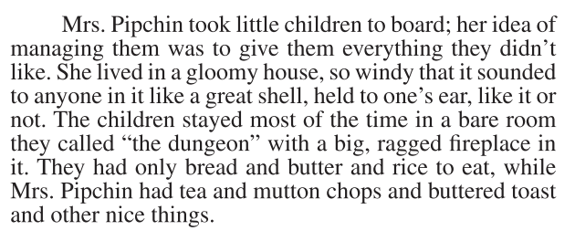
Accuracy
X.1
X.1
X.2
1. In the passage, Mrs. Pipchin managed the children in her boarding house by:
feeding them a poor diet in
contrast to her own.
taking them to the sea coast
to get fresh air.
making them clean “the
dungeon.”
putting them in the care of a
nurse.
Reveal Answer
1 of 5

Slide 4
Accuracy
X.1
X.1
X.2
1. In the passage, Mrs. Pipchin managed the children in her boarding house by:
feeding them a poor diet in
contrast to her own.
taking them to the sea coast
to get fresh air.
making them clean “the
dungeon.”
putting them in the care of a
nurse.
Reveal Answer
2 of 5

Slide 5
Accuracy
X.1
X.1
X.2
1. In the passage, Mrs. Pipchin managed the children in her boarding house by:
feeding them a poor diet in
contrast to her own.
taking them to the sea coast
to get fresh air.
making them clean “the
dungeon.”
putting them in the care of a
nurse.
Reveal Answer
3 of 5

Slide 6
Accuracy
X.1
X.1
X.2
1. In the passage, Mrs. Pipchin managed the children in her boarding house by:
feeding them a poor diet in
contrast to her own.
taking them to the sea coast
to get fresh air.
making them clean “the
dungeon.”
putting them in the care of a
nurse.
Reveal Answer
4 of 5

Slide 7
Accuracy
X.1
X.1
X.2
1. In the passage, Mrs. Pipchin managed the children in her boarding house by:
feeding them a poor diet in
contrast to her own.
taking them to the sea coast
to get fresh air.
making them clean “the
dungeon.”
putting them in the care of a
nurse.
5 of 5

Slide 8
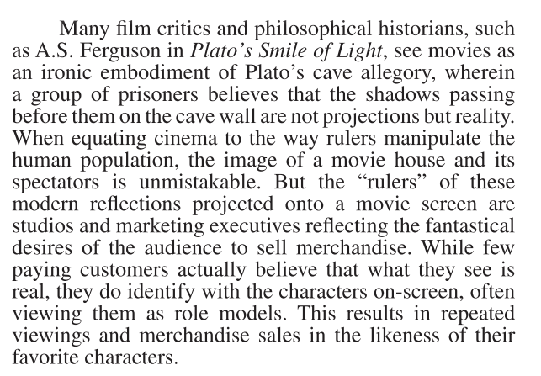
Accuracy
X.1
X.1
X.2
2. In the context of the passage, the author equates Plato’s cave allegory to modern cinema audiences (lines 10–17) primarily to emphasize:
the physical similarities between
shadows on a wall and reflections of
light on a movie screen.
that the distortion of true reality is
present in both the cave and the movie
house.
that modern movie houses were
inspired by Plato’s ideas about reality
and perception.
that the author hopes readers will be
persuaded by Ferguson’s unpopular
theory.
Reveal Answer
1 of 4

Slide 9
Accuracy
X.1
X.1
X.2
2. In the context of the passage, the author equates Plato’s cave allegory to modern cinema audiences (lines 10–17) primarily to emphasize:
the physical similarities between
shadows on a wall and reflections of
light on a movie screen.
that the distortion of true reality is
present in both the cave and the movie
house.
that modern movie houses were
inspired by Plato’s ideas about reality
and perception.
that the author hopes readers will be
persuaded by Ferguson’s unpopular
theory.
Reveal Answer
2 of 4

Slide 10
Accuracy
X.1
X.1
X.2
2. In the context of the passage, the author equates Plato’s cave allegory to modern cinema audiences (lines 10–17) primarily to emphasize:
the physical similarities between
shadows on a wall and reflections of
light on a movie screen.
that the distortion of true reality is
present in both the cave and the movie
house.
that modern movie houses were
inspired by Plato’s ideas about reality
and perception.
that the author hopes readers will be
persuaded by Ferguson’s unpopular
theory.
Reveal Answer
3 of 4

Slide 11
Accuracy
X.1
X.1
X.2
2. In the context of the passage, the author equates Plato’s cave allegory to modern cinema audiences (lines 10–17) primarily to emphasize:
the physical similarities between
shadows on a wall and reflections of
light on a movie screen.
that the distortion of true reality is
present in both the cave and the movie
house.
that modern movie houses were
inspired by Plato’s ideas about reality
and perception.
that the author hopes readers will be
persuaded by Ferguson’s unpopular
theory.
1 of 5
4 of 4

