Slide 1
Test Mastery
Mini-Lesson 5 | English
Accuracy

Slide 2
Accuracy
Learning Targets
Eliminate answer choices that appear correct at first glance
but have incorrect elements.
Avoid wasting time evaluating outlier options.
Identify common errors that decrease accuracy.

Slide 3
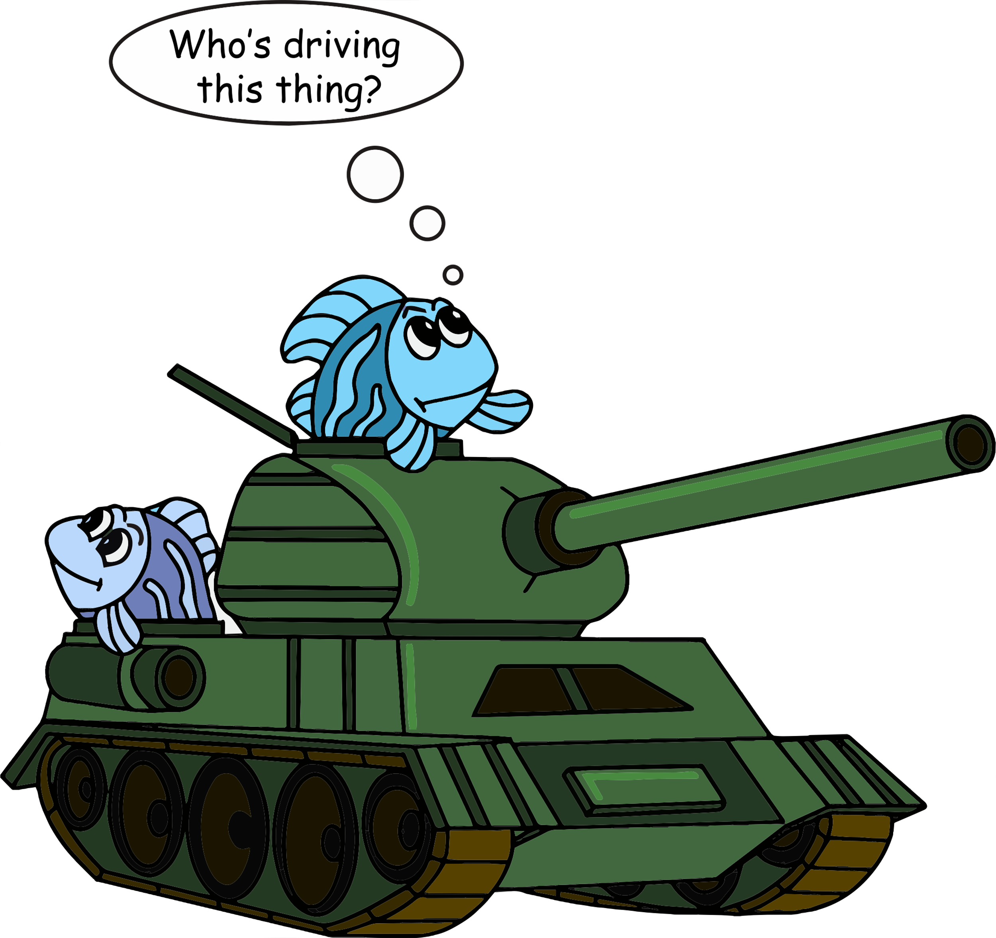
Accuracy
X.1
X.1
X.2

Slide 4
Accuracy
X.2
X.1
X.2
When I visited the beach the next year, I noticed for the first time what a massive variety of shells were on the shore.
1. A) NO CHANGE
B) massive variety of shells was
C) massive variety, of shells was
D) massive variety of shells
Reveal Answer
1 of 3

Slide 5
Accuracy
X.2
X.1
X.2
When I visited the beach the next year, I noticed for the first time what a massive variety of shells were on the shore.
1. A) NO CHANGE
B) massive variety of shells was
C) massive variety, of shells was
D) massive variety of shells
Reveal Answer
2 of 3

Slide 6
Accuracy
X.2
X.1
X.2
When I visited the beach the next year, I noticed for the first time what a massive variety of shells were on the shore.
1. A) NO CHANGE
B) massive variety of shells was
C) massive variety, of shells was
D) massive variety of shells
3 of 3

Slide 7
Accuracy
X.1
X.1
X.2
This all changed in the late 1960s, when Apollo 11 succeeded in it’s mission of landing the first humans on the moon.
2. F) NO CHANGE
G) there
H) its
J) its’
Reveal Answer
1 of 5

Slide 8
Accuracy
X.1
X.1
X.2
This all changed in the late 1960s, when Apollo 11 succeeded in it’s mission of landing the first humans on the moon.
2. F) NO CHANGE
G) there
H) its
J) its’
Reveal Answer
2 of 5

Slide 9
Accuracy
X.1
X.1
X.2
This all changed in the late 1960s, when Apollo 11 succeeded in it’s mission of landing the first humans on the moon.
2. F) NO CHANGE
G) there
H) its
J) its’
Reveal Answer
3 of 5

Slide 10
Accuracy
X.1
X.1
X.2
This all changed in the late 1960s, when Apollo 11 succeeded in it’s mission of landing the first humans on the moon.
2. F) NO CHANGE
G) there
H) its
J) its’
Reveal Answer
4 of 5

Slide 11
Accuracy
X.1
X.1
X.2
This all changed in the late 1960s, when Apollo 11 succeeded in it’s mission of landing the first humans on the moon.
2. F) NO CHANGE
G) there
H) its
J) its’
5 of 5

Slide 12
Accuracy
X.1
X.1
X.2
I am a better person today, because I grew up with her in my life.
3. A) NO CHANGE
B) today, since
C) today because
D) today therefore
Reveal Answer
1 of 3

Slide 13
Accuracy
X.1
X.1
X.2
I am a better person today, because I grew up with her in my life.
3. A) NO CHANGE
B) today, since
C) today because
D) today therefore
Reveal Answer
2 of 3

Slide 14
Accuracy
X.1
X.1
X.2
I am a better person today, because I grew up with her in my life.
3. A) NO CHANGE
B) today, since
C) today because
D) today therefore
3 of 3

