Slide 1
Time Mastery
Mini-Lesson 4 | Reading
Pacing

Slide 2
Pacing
X.1
X.2
Learning Targets
Summarize the importance of pace during the ACT.
Compare the time limit to the number of questions on a
subject test to calculate an effective pace.
Practice using a pacing plan during a mini-test.

Slide 3
Pacing
X.1
X.1
X.2
Instructions
Complete the mini-test.
1 of 1

Slide 4
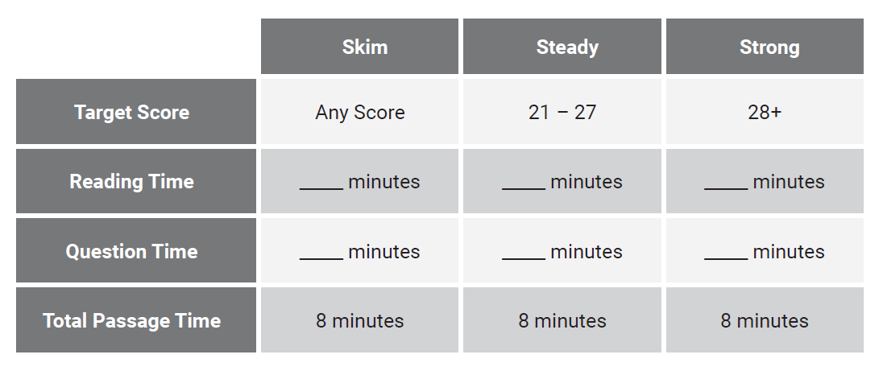
Pacing
X.1
X.1
X.2
Reveal All Answers
1 of 6

Slide 5
Pacing
X.1
X.1
X.2
3
Reveal All Answers
2 of 6

Slide 6
Pacing
X.1
X.1
X.2
3
5
Reveal All Answers
3 of 6

Slide 7
Pacing
X.1
X.1
X.2
3
4
5
4
Reveal All Answers
4 of 6

Slide 8
Pacing
X.1
X.1
X.2
3
4
5
5
4
Reveal All Answers
5 of 6

Slide 9
Pacing
X.1
X.1
X.2
3
4
5
5
4
3
6 of 6

Slide 10
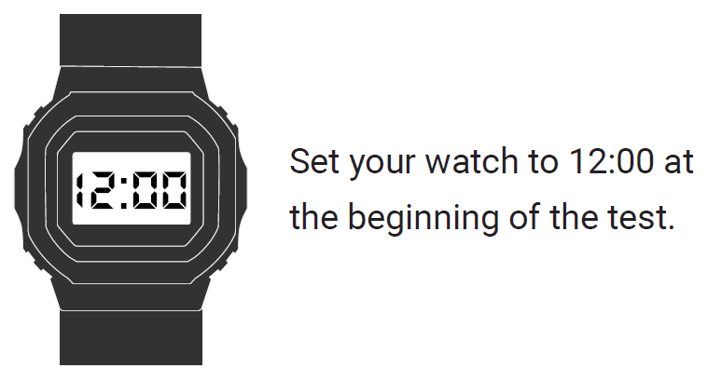
Pacing
X.1
X.1
X.2
1 of 1

Slide 11
Pacing
X.2
X.1
X.2
If you set your watch to noon at the start of the test, what time will your watch say when you begin each section of the test?
Passage 1: 12:00 Passage 4:
Passage 2: Check your work:
Passage 3: The test ends:
Reveal All Answers
1 of 5

Slide 12
Pacing
X.2
X.1
X.2
If you set your watch to noon at the start of the test, what time will your watch say when you begin each section of the test?
Passage 1: 12:00 Passage 4:
Passage 2: 12:08 Check your work:
Passage 3: The test ends:
Reveal All Answers
1 of 5

Slide 13
Pacing
X.2
X.1
X.2
If you set your watch to noon at the start of the test, what time will your watch say when you begin each section of the test?
Passage 1: 12:00 Passage 4:
Passage 2: 12:08 Check your work:
Passage 3: 12:16 The test ends:
Reveal All Answers
1 of 5

Slide 14
Pacing
X.2
X.1
X.2
If you set your watch to noon at the start of the test, what time will your watch say when you begin each section of the test?
Passage 1: 12:00 Passage 4: 12:24
Passage 2: 12:08 Check your work:
Passage 3: 12:16 The test ends:
Reveal All Answers
1 of 5

Slide 15
Pacing
X.2
X.1
X.2
If you set your watch to noon at the start of the test, what time will your watch say when you begin each section of the test?
Passage 1: 12:00 Passage 4: 12:24
Passage 2: 12:08 Check your work: 12:32
Passage 3: 12:16 The test ends:
Reveal All Answers
1 of 5

Slide 16
Pacing
X.2
X.1
X.2
If you set your watch to noon at the start of the test, what time will your watch say when you begin each section of the test?
Passage 1: 12:00 Passage 4: 12:24
Passage 2: 12:08 Check your work: 12:32
Passage 3: 12:16 The test ends: 12:40
1 of 5

Slide 17
Pacing
X.1
X.1
X.2
Instructions
Complete the mini-test.
1 of 1

Slide 18
Pacing
X.2
X.1
X.2
Answer Key
31. 36.
32. 37.
33. 38.
34. 39.
35. 40.
Reveal All Answers
1 of 11

Slide 19
Pacing
X.2
X.1
X.2
Answer Key
31. B 36.
32. 37.
33. 38.
34. 39.
35. 40.
Reveal All Answers
2 of 11

Slide 20
Pacing
X.2
X.1
X.2
Answer Key
31. B 36.
32. H 37.
33. 38.
34. 39.
35. 40.
Reveal All Answers
3 of 11

Slide 21
Pacing
X.2
X.1
X.2
Answer Key
31. B 36.
32. H 37.
33. B 38.
34. 39.
35. 40.
Reveal All Answers
4 of 11

Slide 22
Pacing
X.2
X.1
X.2
Answer Key
31. B 36.
32. H 37.
33. B 38.
34. J 39.
35. 40.
Reveal All Answers
5 of 11

Slide 23
Pacing
X.2
X.1
X.2
Answer Key
31. B 36.
32. H 37.
33. B 38.
34. J 39.
35. A 40.
Reveal All Answers
6 of 11

Slide 24
Pacing
X.2
X.1
X.2
Answer Key
31. B 36. F
32. H 37.
33. B 38.
34. J 39.
35. A 40.
Reveal All Answers
7 of 11

Slide 25
Pacing
X.2
X.1
X.2
Answer Key
31. B 36. F
32. H 37. C
33. B 38.
34. J 39.
35. A 40.
Reveal All Answers
8 of 11

Slide 26
Pacing
X.2
X.1
X.2
Answer Key
31. B 36. F
32. H 37. C
33. B 38. F
34. J 39.
35. A 40.
Reveal All Answers
9 of 11

Slide 27
Pacing
X.2
X.1
X.2
Answer Key
31. B 36. F
32. H 37. C
33. B 38. F
34. J 39. D
35. A 40.
Reveal All Answers
10 of 11

Slide 28
Pacing
X.2
X.1
X.2
Answer Key
31. B 36. F
32. H 37. C
33. B 38. F
34. J 39. D
35. A 40. H
11 of 11

