Slide 1
Time Mastery
Mini-Lesson 4 | Math
Pacing

Slide 2
Pacing
X.1
X.2
Learning Targets
Summarize the importance of pace during the ACT.
Pick a pacing plan that goes with your target Math score.
Practice using a pacing plan during a mini-test.

Slide 3
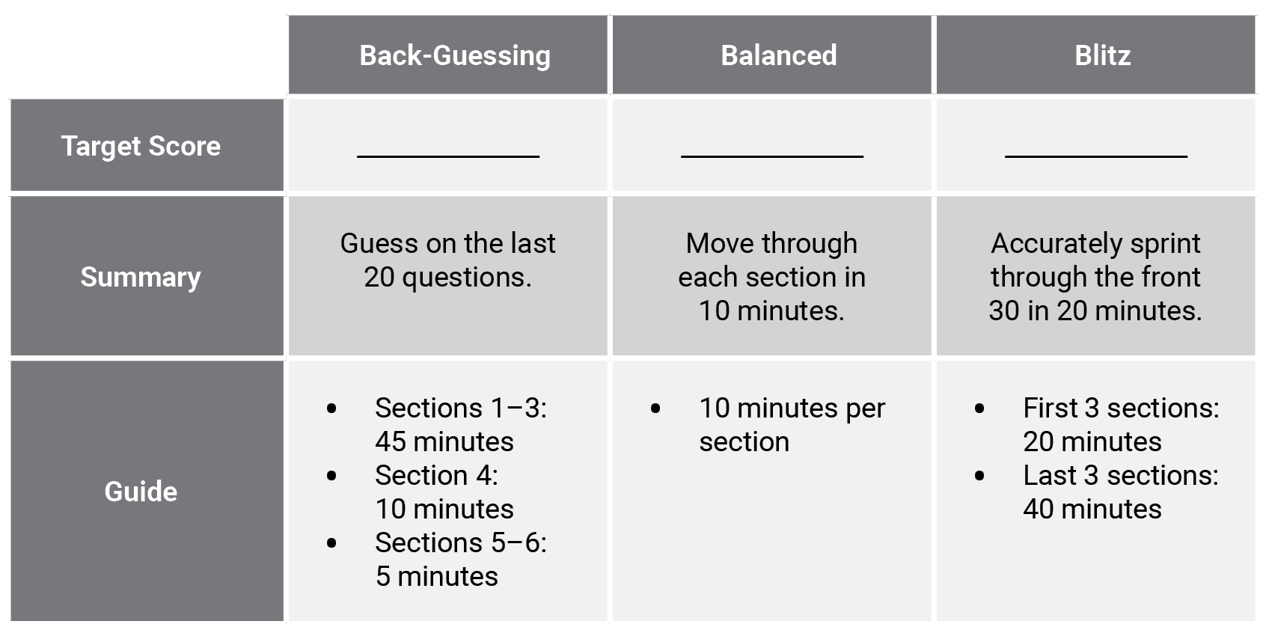
Pacing
X.1
Reveal All Answers
1 of 4

Slide 4
Pacing
X.1
< 21
Reveal All Answers
2 of 4

Slide 5
Pacing
X.1
< 21
21–25
Reveal All Answers
3 of 4

Slide 6
Pacing
X.1
< 21
21–25
> 25
4 of 4

Slide 7
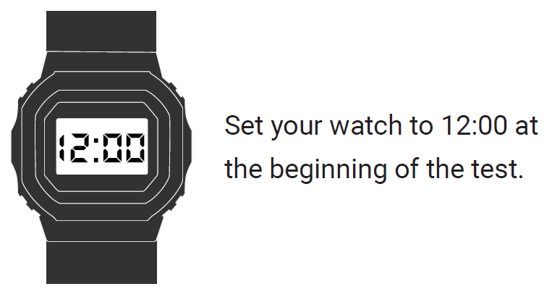
Pacing
X.1
1 of 1

Slide 8
Pacing
X.2
If you set your watch to noon at the start of the test, what time will your watch say when you begin each section of the test?
Back-Guessing
Section 1: 12:00 Section 5: 12:55
Section 2: 12:15 Check your work: 12:57 (or 12:58)
Section 3: 12:30 The test ends: 1:00
Section 4: 12:45
1 of 3

Slide 9
Pacing
X.2
If you set your watch to noon at the start of the test, what time will your watch say when you begin each section of the test?
Balanced
Section 1: 12:00 Section 5: 12:40
Section 2: 12:10 Check your work: 12:50
Section 3: 12:20 The test ends: 1:00
Section 4: 12:30
2 of 3

Slide 10
Pacing
X.2
If you set your watch to noon at the start of the test, what time will your watch say when you begin each section of the test?
Blitz
Sections 1–3: 12:00 Check your work: varies
Section 4: 12:20 The test ends: 1:00
Section 5: varies
3 of 3

Slide 11
Pacing
X.1
Instructions
Complete the mini-test.
1 of 1

Slide 12
Pacing
X.1
Answer Key
36.
37.
38.
39.
40.
Reveal All Answers
1 of 11

Slide 13
Pacing
X.1
Answer Key
E
36.
37.
38.
39.
40.
Reveal All Answers
2 of 11

Slide 14
Pacing
X.1
Answer Key
E
J
36.
37.
38.
39.
40.
Reveal All Answers
3 of 11

Slide 15
Pacing
X.1
Answer Key
E
J
C
36.
37.
38.
39.
40.
Reveal All Answers
4 of 11

Slide 16
Pacing
X.1
Answer Key
E
J
C
K
36.
37.
38.
39.
40.
Reveal All Answers
5 of 11

Slide 17
Pacing
X.1
Answer Key
E
J
C
K
D
36.
37.
38.
39.
40.
Reveal All Answers
6 of 11

Slide 18
Pacing
X.1
Answer Key
E
J
C
K
D
36. J
37.
38.
39.
40.
Reveal All Answers
7 of 11

Slide 19
Pacing
X.1
Answer Key
E
J
C
K
D
36. J
37. C
38.
39.
40.
Reveal All Answers
8 of 11

Slide 20
Pacing
X.1
Answer Key
E
J
C
K
D
36. J
37. C
38. H
39.
40.
Reveal All Answers
9 of 11

Slide 21
Pacing
X.1
Answer Key
E
J
C
K
D
36. J
37. C
38. H
39. D
40.
Reveal All Answers
10 of 11

Slide 22
Pacing
X.1
Answer Key
E
J
C
K
D
36. J
37. C
38. H
39. D
40. G
11 of 11

