Slide 1
Time Mastery
Mini-Lesson 4 | English
Pacing

Slide 2
Pacing
Learning Targets
Summarize the importance of pace during the ACT.
Compare the time limit to the number of questions on a
subject test to calculate an effective pace.
Practice using a pacing plan during a mini-test.

Slide 3
Pacing
X.1
X.1
X.2
Instructions
Complete the mini-test.
1 of 1

Slide 4
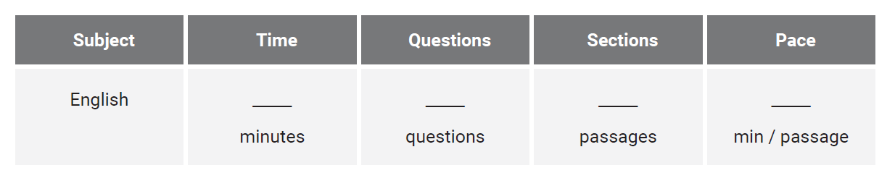
Pacing
X.1
X.1
X.2
Reveal All Answers
1 of 5

Slide 5
Pacing
X.1
X.1
X.2
45
Reveal All Answers
2 of 5

Slide 6
Pacing
X.1
X.1
X.2
45
75
Reveal All Answers
3 of 5

Slide 7
Pacing
X.1
X.1
X.2
45
75
5
Reveal All Answers
4 of 5

Slide 8
Pacing
X.1
X.1
X.2
45
75
5
8
5 of 5

Slide 9
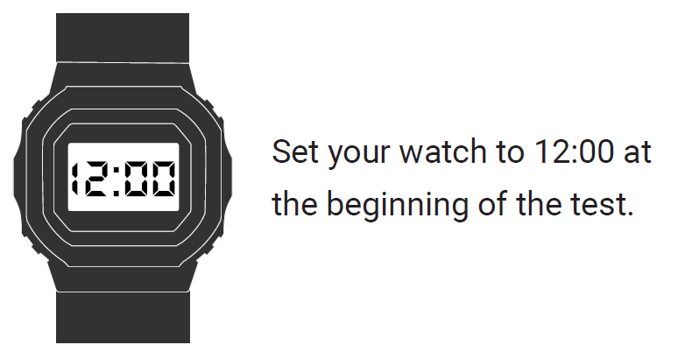
Pacing
X.1
X.1
X.2
1 of 1

Slide 10
Pacing
X.2
X.1
X.2
If you set your watch to noon at the start of the test, what time will your watch say when you begin each section of the test?
Passage 1: 12:00 Passage 5:
Passage 2: Check your work:
Passage 3: The test ends:
Passage 4:
Reveal All Answers
1 of 5

Slide 11
Pacing
X.2
X.1
X.2
If you set your watch to noon at the start of the test, what time will your watch say when you begin each section of the test?
Passage 1: 12:00 Passage 5:
Passage 2: 12:08 Check your work:
Passage 3: The test ends:
Passage 4:
Reveal All Answers
1 of 5

Slide 12
Pacing
X.2
X.1
X.2
If you set your watch to noon at the start of the test, what time will your watch say when you begin each section of the test?
Passage 1: 12:00 Passage 5:
Passage 2: 12:08 Check your work:
Passage 3: The test ends:
Passage 4:
Reveal All Answers
1 of 5

Slide 13
Pacing
X.2
X.1
X.2
If you set your watch to noon at the start of the test, what time will your watch say when you begin each section of the test?
Passage 1: 12:00 Passage 5:
Passage 2: 12:08 Check your work:
Passage 3: 12:16 The test ends:
Passage 4:
Reveal All Answers
1 of 5

Slide 14
Pacing
X.2
X.1
X.2
If you set your watch to noon at the start of the test, what time will your watch say when you begin each section of the test?
Passage 1: 12:00 Passage 5:
Passage 2: 12:08 Check your work:
Passage 3: 12:16 The test ends:
Passage 4: 12:24
Reveal All Answers
1 of 5

Slide 15
Pacing
X.2
X.1
X.2
If you set your watch to noon at the start of the test, what time will your watch say when you begin each section of the test?
Passage 1: 12:00 Passage 5:
Passage 2: 12:08 Check your work:
Passage 3: 12:16 The test ends:
Passage 4: 12:24
Reveal All Answers
1 of 5

Slide 16
Pacing
X.2
X.1
X.2
If you set your watch to noon at the start of the test, what time will your watch say when you begin each section of the test?
Passage 1: 12:00 Passage 5: 12:32
Passage 2: 12:08 Check your work:
Passage 3: 12:16 The test ends:
Passage 4: 12:24
Reveal All Answers
1 of 5

Slide 17
Pacing
X.2
X.1
X.2
If you set your watch to noon at the start of the test, what time will your watch say when you begin each section of the test?
Passage 1: 12:00 Passage 5: 12:32
Passage 2: 12:08 Check your work: 12:40
Passage 3: 12:16 The test ends: 12:45
Passage 4: 12:24
1 of 5

Slide 18
Pacing
X.1
X.1
X.2
Instructions
Complete the mini-test.
1 of 1

Slide 19
Pacing
X.2
X.1
X.2
Answer Key
Reveal All Answers
1 of 16

Slide 20
Pacing
X.2
X.1
X.2
Answer Key
A
Reveal All Answers
2 of 16

Slide 21
Pacing
X.2
X.1
X.2
Answer Key
A
H
Reveal All Answers
3 of 16

Slide 22
Pacing
X.2
X.1
X.2
Answer Key
A
H
A
Reveal All Answers
4 of 16

Slide 23
Pacing
X.2
X.1
X.2
Answer Key
A
H
A
G
Reveal All Answers
5 of 16

Slide 24
Pacing
X.2
X.1
X.2
Answer Key
A
H
A
G
A
Reveal All Answers
6 of 16

Slide 25
Pacing
X.2
X.1
X.2
Answer Key
A
H
A
G
A
F
Reveal All Answers
7 of 16

Slide 26
Pacing
X.2
X.1
X.2
Answer Key
A
H
A
G
A
F
B
Reveal All Answers
8 of 16

Slide 27
Pacing
X.2
X.1
X.2
Answer Key
A
H
A
G
A
F
B
J
Reveal All Answers
9 of 16

Slide 28
Pacing
X.2
X.1
X.2
Answer Key
A
H
A
G
A
F
B
J
D
Reveal All Answers
10 of 16

Slide 29
Pacing
X.2
X.1
X.2
Answer Key
A
H
A
G
A
F
B
J
D
G
Reveal All Answers
11 of 16

Slide 30
Pacing
X.2
X.1
X.2
Answer Key
A
H
A
G
A
F
B
J
D
G
B
Reveal All Answers
12 of 16

Slide 31
Pacing
X.2
X.1
X.2
Answer Key
A
H
A
G
A
F
B
J
D
G
B
J
Reveal All Answers
13 of 16

Slide 32
Pacing
X.2
X.1
X.2
Answer Key
A
H
A
G
A
F
B
J
D
G
B
J
C
Reveal All Answers
14 of 16

Slide 33
Pacing
X.2
X.1
X.2
Answer Key
A
H
A
G
A
F
B
J
D
G
B
J
C
F
Reveal All Answers
15 of 16

Slide 34
Pacing
X.2
X.1
X.2
Answer Key
A
H
A
G
A
F
B
J
D
G
B
J
C
F
D
16 of 16

