Slide 1
Time Mastery
Mini-Lesson 2 | Math
Answer Awareness

Slide 2
Answer Awareness
X.1
X.2
Learning Targets
Use the structure of the answer choices to avoid unnecessary
precision or consideration.
Identify clues in the answer choices to save time and increase
focus.

Slide 3
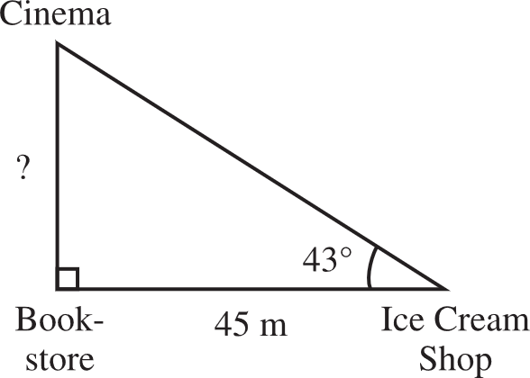
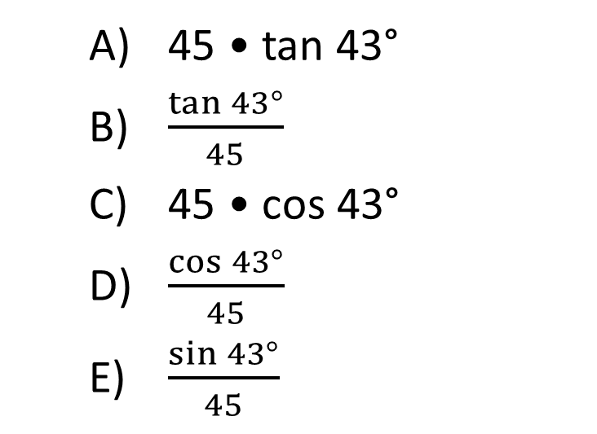
Answer Awareness
X.1
1. According to the measurements given in the figure below, which of the following expressions gives the distance, in meters, from the cinema to the bookstore?
45 • tan 43°
$\frac{\tan{43°}}{45}$
45 • cos 43°
$\frac{\cos{43°}}{45}$
$\frac{\sin{43°}}{45}$
Reveal Answer
1 of 3

Slide 4
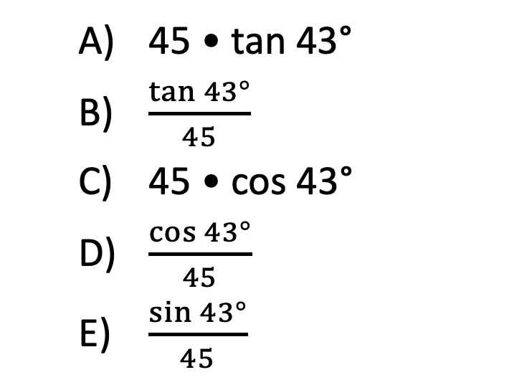
Answer Awareness
X.1
1. According to the measurements given in the figure below, which of the following expressions gives the distance, in meters, from the cinema to the bookstore?
45 • tan 43°
$\frac{\tan{43°}}{45}$
45 • cos 43°
$\frac{\cos{43°}}{45}$
$\frac{\sin{43°}}{45}$
Reveal Answer
2 of 3

Slide 5
Answer Awareness
X.1
1. According to the measurements given in the figure below, which of the following expressions gives the distance, in meters, from the cinema to the bookstore?
45 • tan 43°
$\frac{\tan{43°}}{45}$
45 • cos 43°
$\frac{\cos{43°}}{45}$
$\frac{\sin{43°}}{45}$
3 of 3

