Slide 1
Test Mastery
Mini-Lesson 1 | Reading
Orientation

Slide 2
Orientation
X.1
X.2
Learning Targets
Explain how attending college can impact income and life
expectancy.
Create a “why” for preparing for the ACT.
Summarize how the ACT is scored.
Determine the number of correct answers needed to achieve
a goal score.

Slide 3
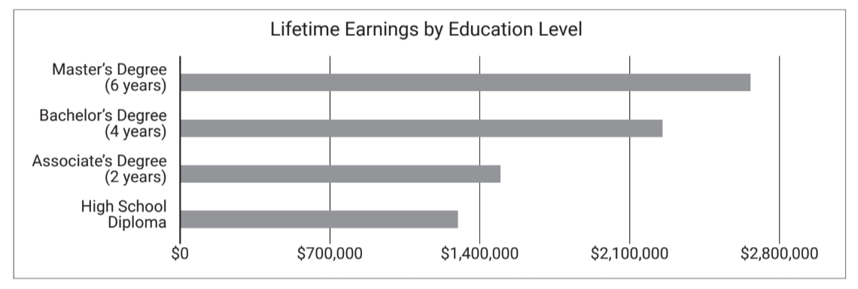
Orientation
X.1
X.1
X.2
1 of 1

Slide 4
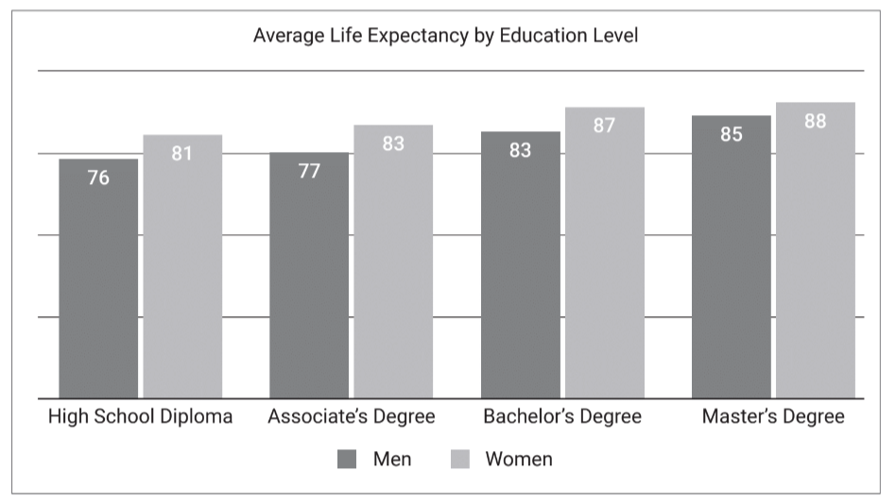
Orientation
X.2
X.1
X.2
1 of 1

Slide 5
Orientation
X.1
X.1
X.2
Instructions
Write your responses to questions 1–3 in the spaces provided.
1 of 1

Slide 6
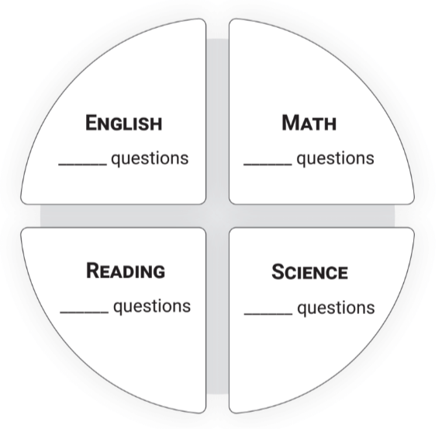
Orientation
X.1
X.1
X.2
Reveal All Answers
1 of 5

Slide 7
Orientation
X.1
X.1
X.2
75
Reveal All Answers
2 of 5

Slide 8
Orientation
X.1
X.1
X.2
75
60
Reveal All Answers
3 of 5

Slide 9
Orientation
X.1
X.1
X.2
75
60
40
Reveal All Answers
4 of 5

Slide 10
Orientation
X.1
X.1
X.2
75
60
40
40
5 of 5

Slide 11
Orientation
X.2
X.1
X.2
4. You can score between 1 and ____ points on each subject test. This is called the scale score.
5. Your composite score is the ___________ of your scores for each subject test. This is the score colleges will look at.
Reveal All Answers
1 of 3

Slide 12
Orientation
X.2
X.1
X.2
36
4. You can score between 1 and ____ points on each subject test. This is called the scale score.
5. Your composite score is the ___________ of your scores for each subject test. This is the score colleges will look at.
Reveal All Answers
2 of 3

Slide 13
Orientation
X.2
X.1
X.2
36
4. You can score between 1 and ____ points on each subject test. This is called the scale score.
5. Your composite score is the ___________ of your scores for each subject test. This is the score colleges will look at.
average
3 of 3

Slide 14
Orientation
X.1
X.1
X.2
Instructions
Use the conversion chart to see how many questions you need to get right to reach your goal score.
1 of 1

Slide 15
Orientation
X.2
X.1
X.2
6. What is your goal score for the ACT Reading test?
7. How many questions do you need to get right to earn your goal score?
8. How many questions can you miss or guess and still reach your goal score?
1 of 1

